Slide 1

Claims Description Normalizer
Automating Insurance Claim Understanding with Local LLMs
Presenter: Paneri Fulbandhe

Slide 2
The Problem
Insurance claim descriptions are Unstructured.
Verbose, inconsistent, and messy.
Hard for traditional automation (Regex fails).
Requires manual reading by adjusters.
PAIN POINT:
High operational cost, delays, and inconsistent processing.
Objective
Convert messy, free-text claim notes into clean Structured JSON.
Loss Type
Severity
Affected Asset
Estimated Loss
Incident Date
Confidence Score

Slide 3
Why an On-premise GenAI?
Unique Value Proposition vs. Cloud LLMs
✓ Privacy First:
✓ Cost Efficiency:
No data leaves the system (PII protected).
Zero API billing costs.
✓ Security:
✓ Control:
Works in air-gapped enterprise environments.
Customizable models & quantization.

Slide 4
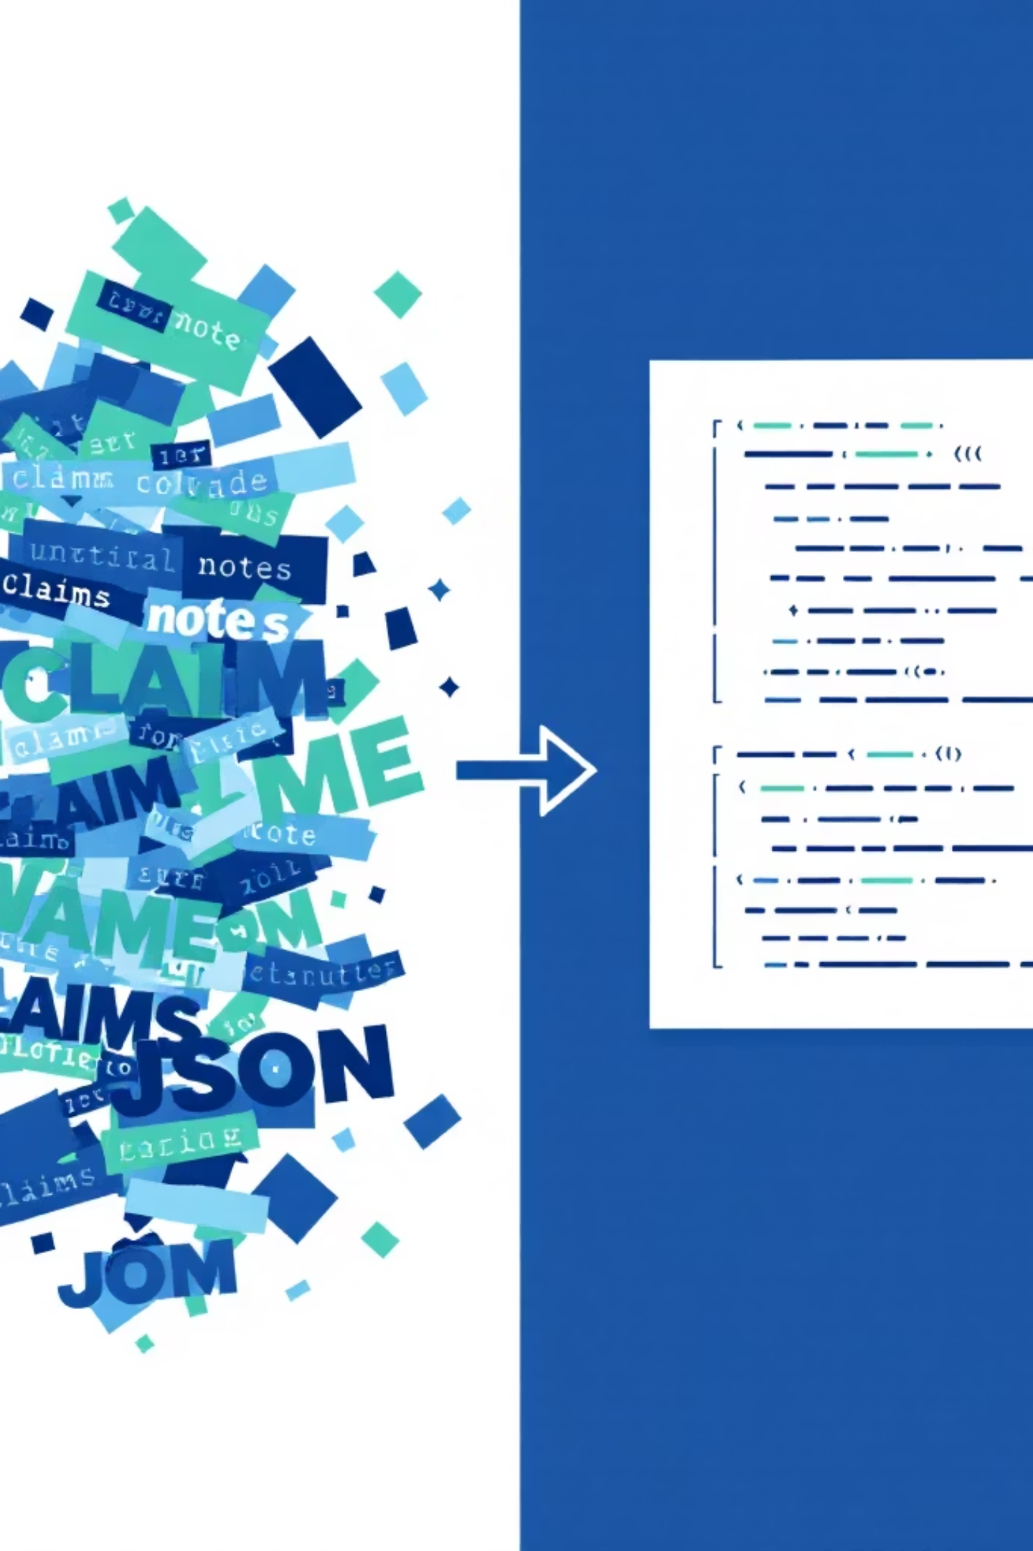
Proposed Solution
Input: Free Text
Output: Validated JSON
History Storage: CSV logging
Analytics: Dashboard for severity & loss types
Explainability: "Why did the AI decide this?"
UI: Clean interface via Gradio

Slide 5
System Architecture
01
02
User Claim Text
UI Layer (Gradio)
The initial input from the user.
User interaction handled by a Gradio interface.
03
04
Prompt Builder (Few-shot)
Local LLM (Mistral 7B + llama.cpp)
Constructs prompts using few-shot learning for the LLM.
Processes the prompt using a local large language model.
05
06
JSON Parser + Pydantic Validator
History (CSV) and Analytics
Parses and validates the LLM output into a structured JSON format.
Stores data in CSV for history and feeds into analytics dashboards.

Slide 6
Prompt Engineering
Strategy: Clear Role Definition & Strong JSON Enforcement
Return ONLY a JSON object:{
"loss_type": "Water/Fire/Theft",
"severity": "Critical/Moderate/Minor",
"asset": "Extracted Asset Name",
"incident_date": "YYYY-MM-DD",
"location": "City, State",
"confidence": "High/Medium/Low",
"explanation": "One sentence reason...“
}

Slide 7
LIVE DEMO
Switching to Application...
Walkthrough Checklist:
Paste messy claim text.
Click "Normalize".
Review Structured JSON output.
Show "Summary" view.
Check "History" tab & Refresh Analytics.

Slide 8
History & Analytics
Practical Business Value
TRACKING
Adjusters can track previously analyzed claims without re-running inference.
INSIGHTS
Severity Trends: Align workload.
Loss Patterns: Identify fraud or risk indicators.
Built with Pandas + Plotly integration.

Slide 9
Competitors vs. Our Solution
Data Privacy
Data leaves premises
100% On-Premise
Cost
Per-token billing
Fixed Hardware Cost
Network
Requires Internet
Air-Gap Ready

Slide 10




Future Enhancements
REST API for integration (FastAPI)
Fine-tuned insurance domain models (LoRA)
RAG-based claim policy lookup
Multi-modal input (Images of damage)

Slide 11

Thank You!
Paneri Fulbandhe
rtrpaneri@gmail.com

